Slide 1



IMPLEMENTATION OF ALU USING REVERSIBLE LOGIC GATES
TEAM MEMBERS:
VAMSHI HARI HARA KIRAN REDDY J - 21BEC1085
BOOSIREDDY MADHAN KUMAR REDDY-21BEC1509
PAPPALA LIKITH-21BEC1742
GUIDE NAME:
CHANDRASEKARAN N

Slide 2
Literature survey
paper details | methodology | conclusion
Comparison of 32-bit ALU for Reversible Logic and Irreversible Logic | The methodology involved designing a 32-bit ALU using reversible logic gates, such as Toffoli and Fredkin, to reduce power and delay. The ALU, built with Verilog HDL, was simulated and synthesized to measure power, speed, and area. The reversible ALU demonstrated lower power usage, faster performance, and smaller area compared to a traditional irreversible ALU​ | 32-bit ALU using reversible logic gates proved to be more efficient than a traditional ALU, showing reduced power use, faster performance, and less area usage. With a 48.91% decrease in delay and a 34% reduction in space, reversible logic offers a promising solution for energy-saving and high-performance VLSI designs

Slide 3
paper details | methodology | conclusion
Design and Synthesis of Reversible Arithmetic and Logic Unit (ALU) | The study designed an 8-bit ALU using reversible logic to reduce power consumption. Two designs were tested: one with a Peres Full Adder Gate (PFAG) and the other with a Haghparast and Navi Gate (HNG) as the main adder. Each ALU design performs eight arithmetic and four logic operations, controlled by three selection lines. Components like Feynman, Fredkin, and R-I gates were used along with either PFAG or HNG. The designs were simulated using Altera Quartus II software to evaluate factors like gate count, garbage output, quantum cost, and delay. | The HNG-based ALU performed better, achieving a quantum cost of 26 and a delay of 8.29 ns for the 8-bit version. This design used 8 gates and produced 10 garbage outputs, making it faster and more efficient than the PFAG-based ALU and conventional ALUs​

Slide 4

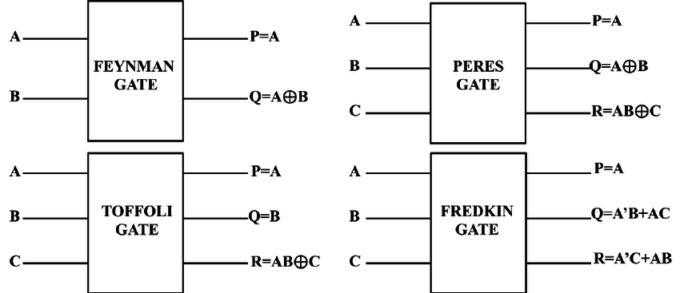
Proposed methodology
we used reversible logic gates like feynman ,peres,toffoli,fredkin

Slide 5



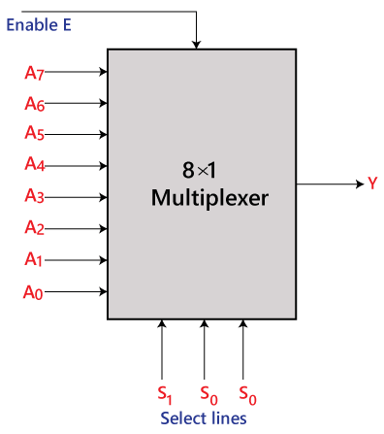
An 8:1 multiplexer (MUX) is a digital switch that selects one of eight input signals and forwards it to a single output based on the values of three control inputs.

Slide 6
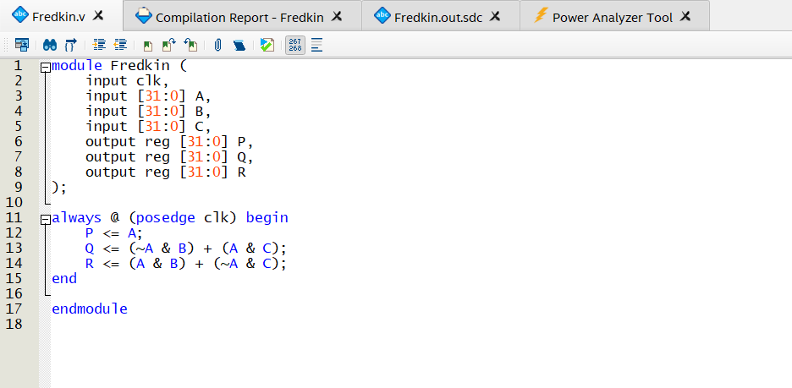
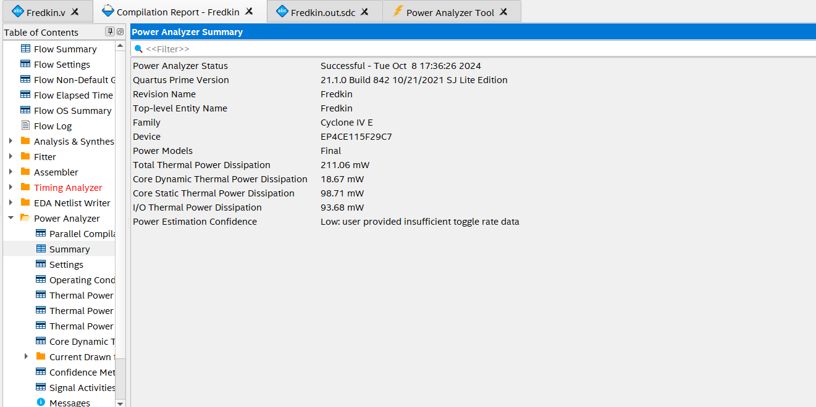
Implementation of Proposed Methodology

Slide 7
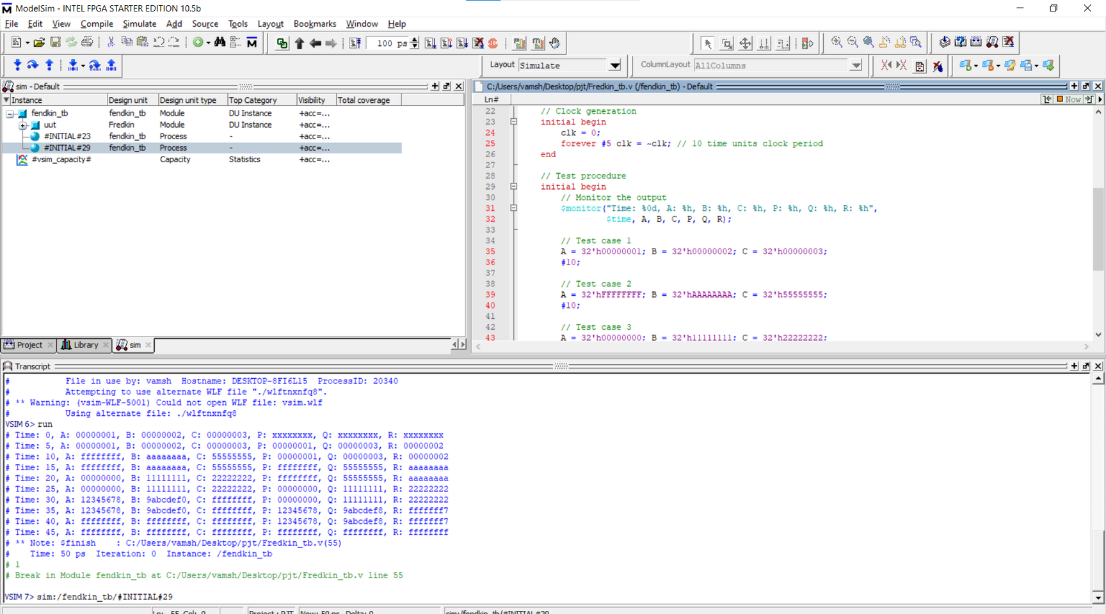

Slide 8
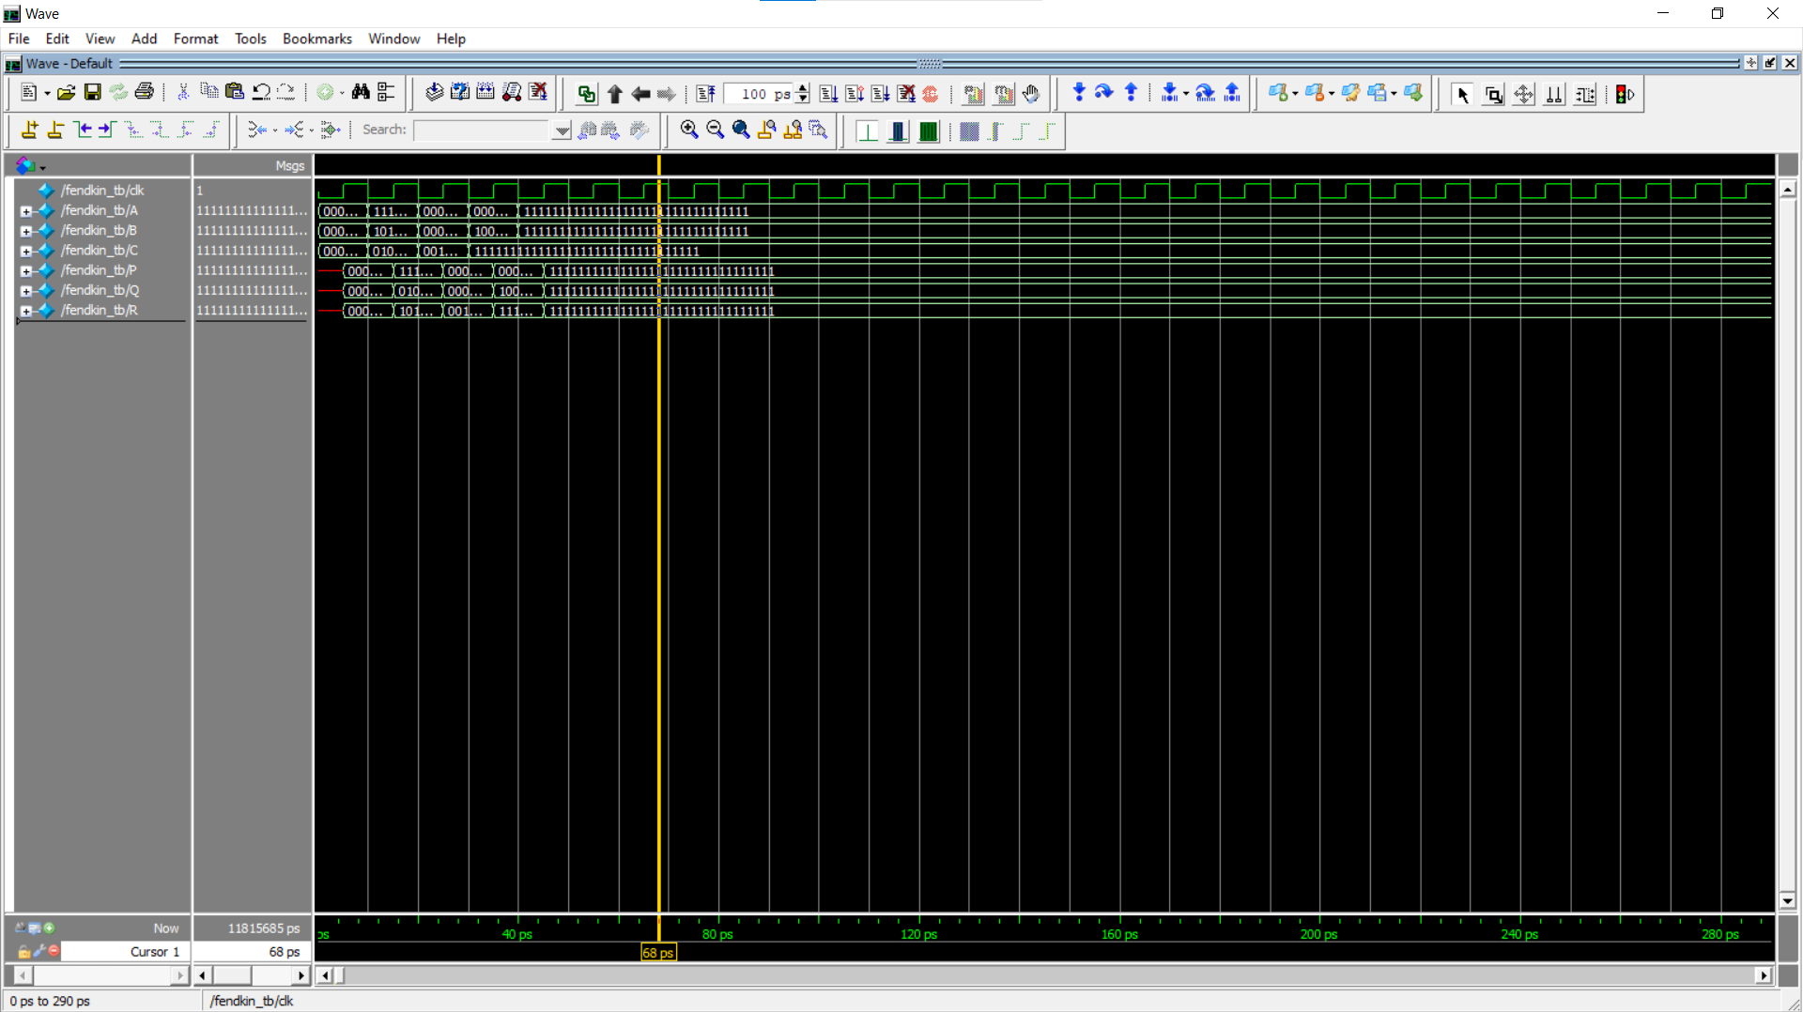

Slide 9
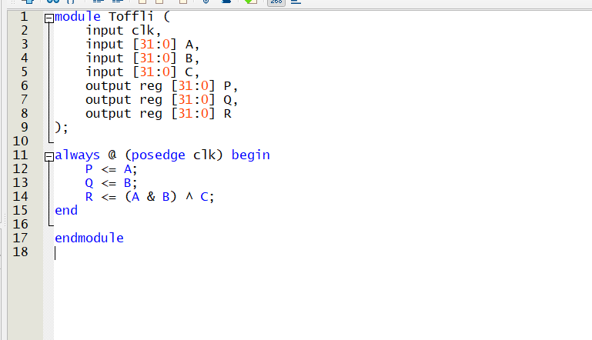
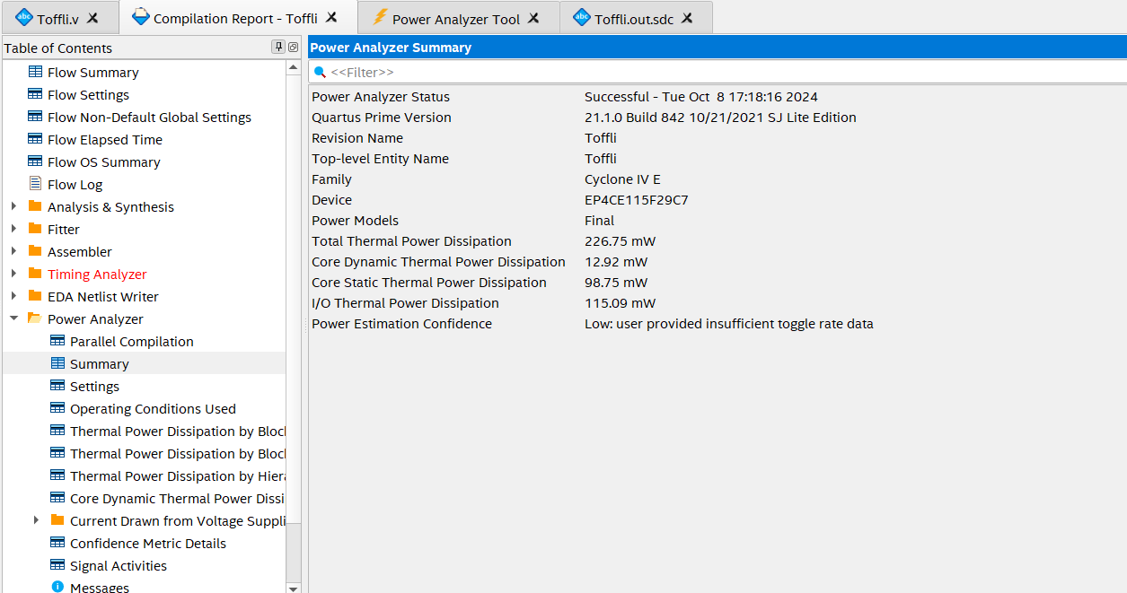
Toffoli gate

Slide 10
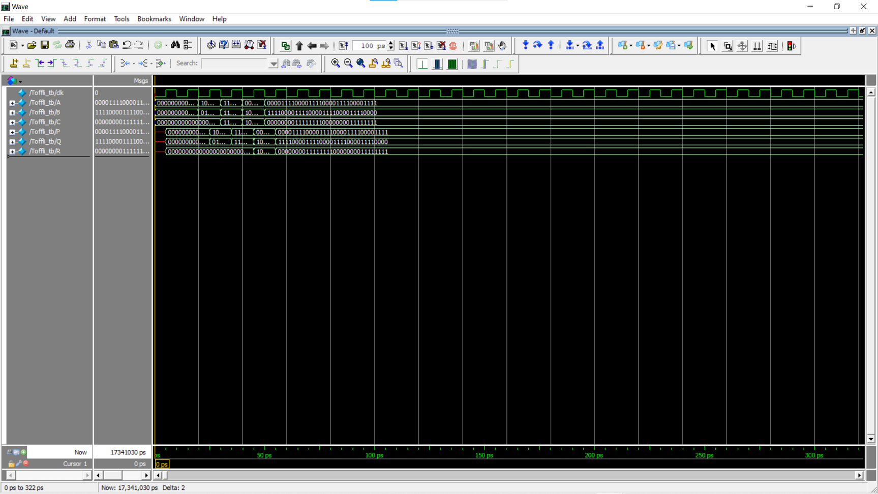

Slide 11
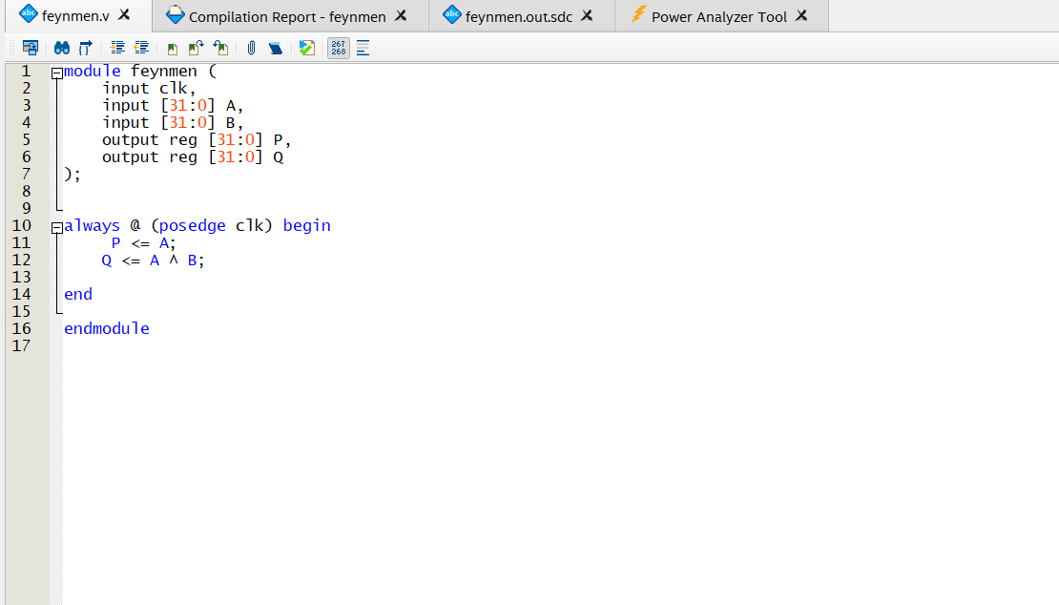
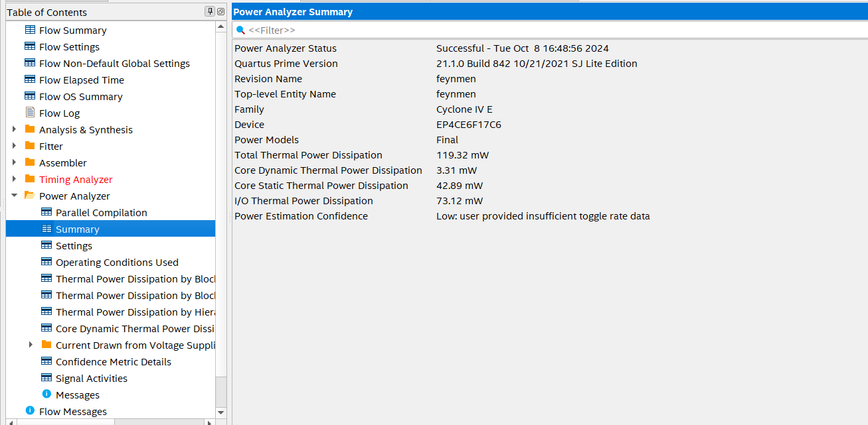
feynman gate

Slide 12
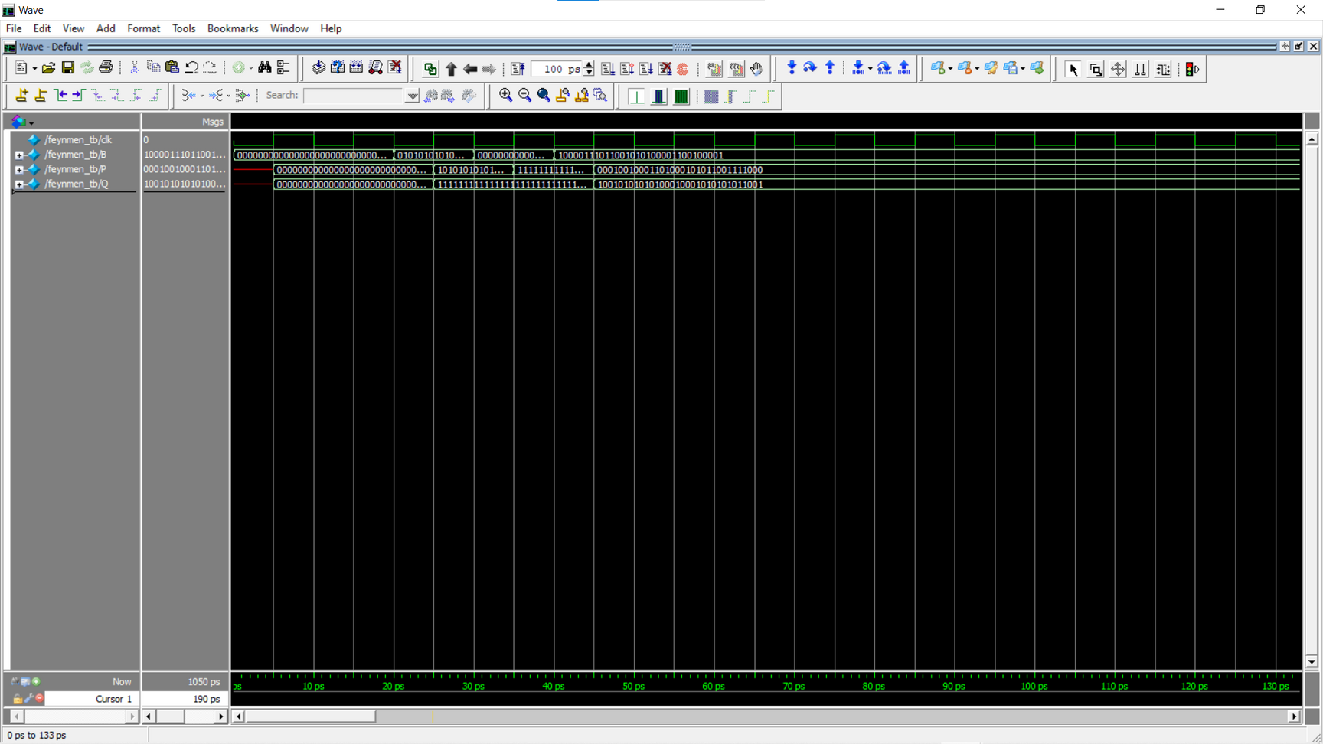

Slide 13
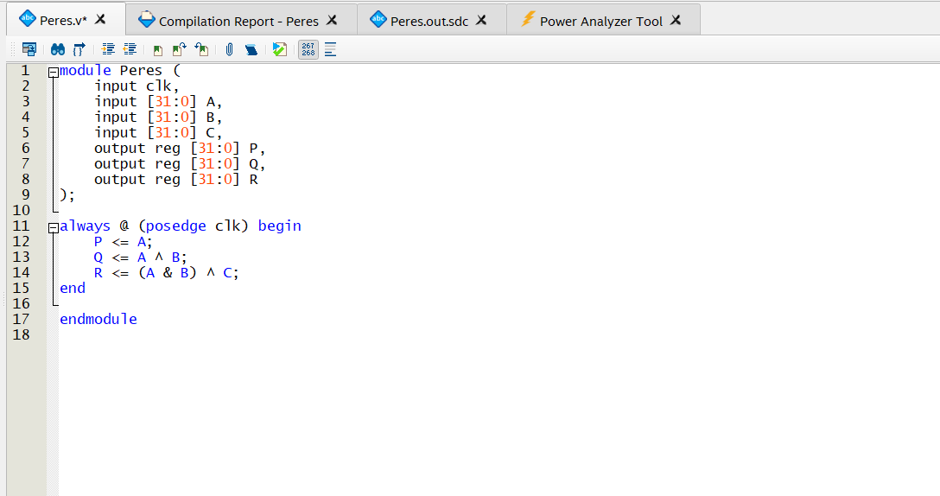

peres gate:

Slide 14
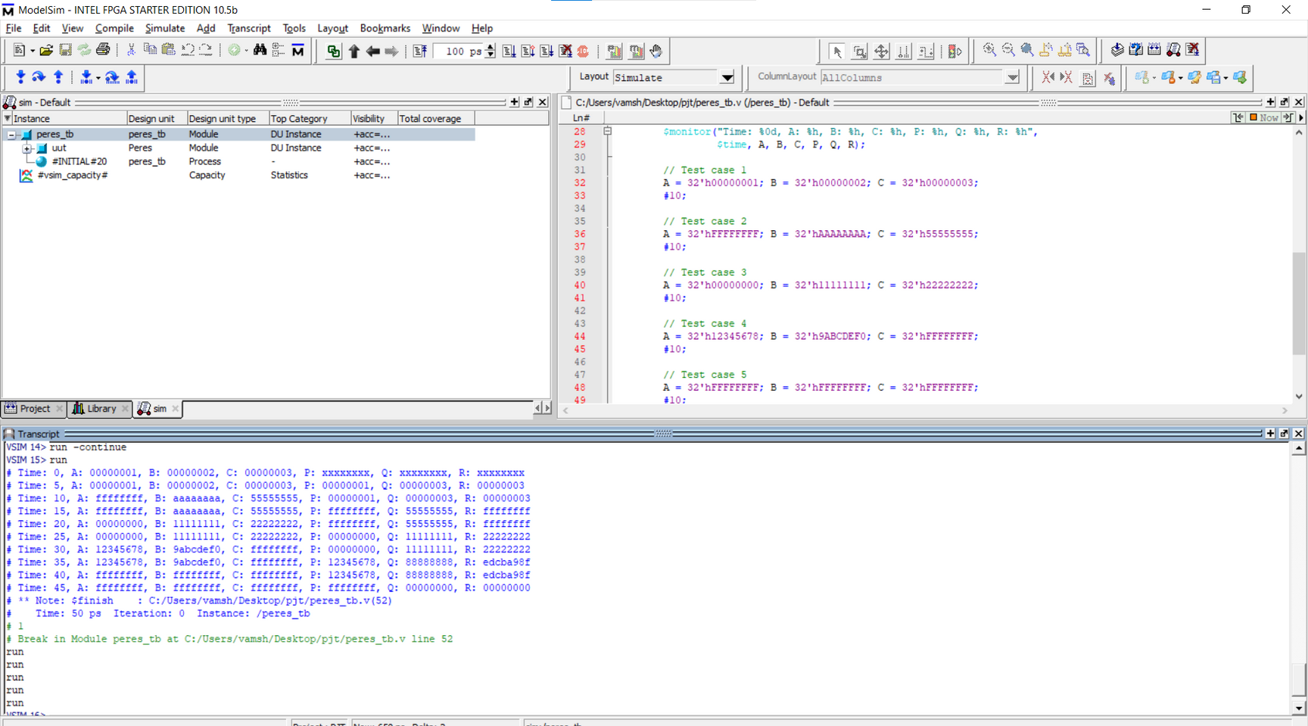

Slide 15
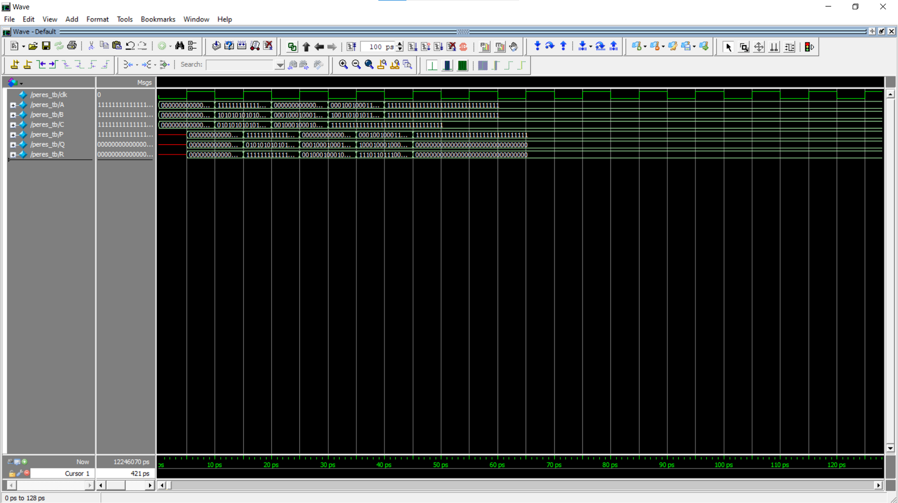

Slide 16
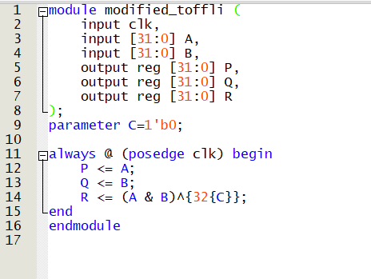
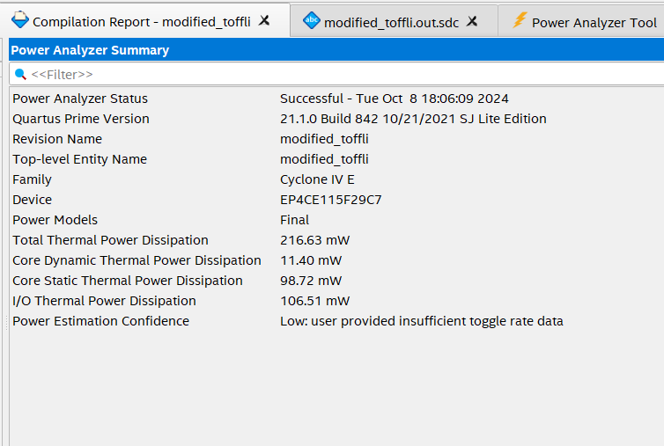
modified toffoli gate:

Slide 17
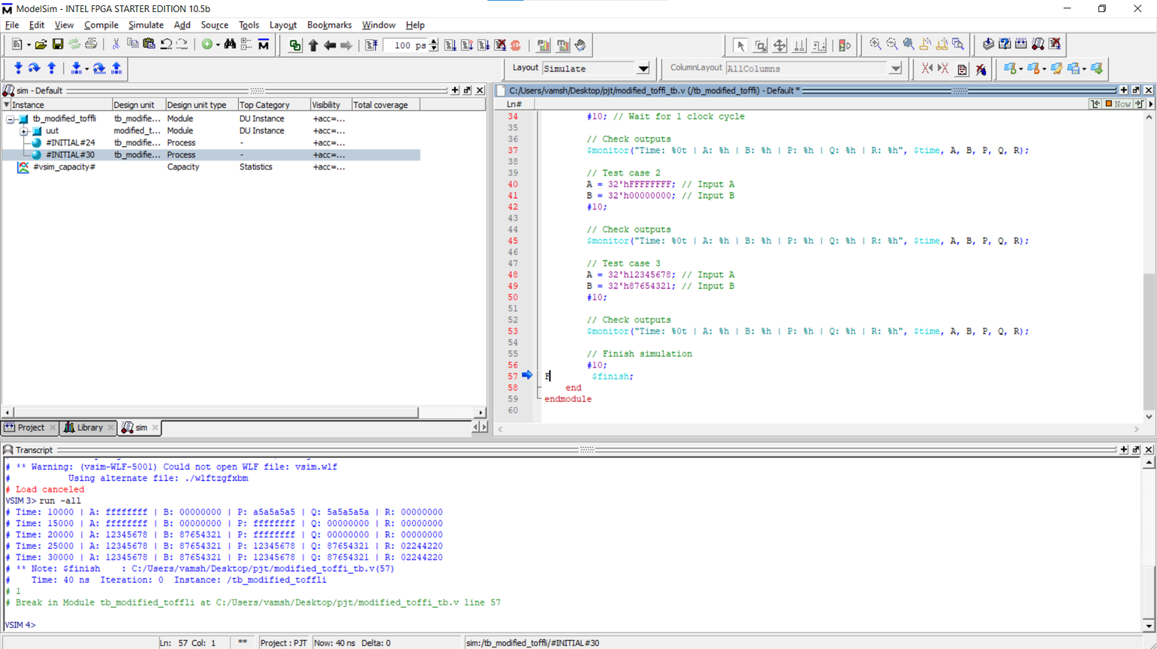

Slide 18
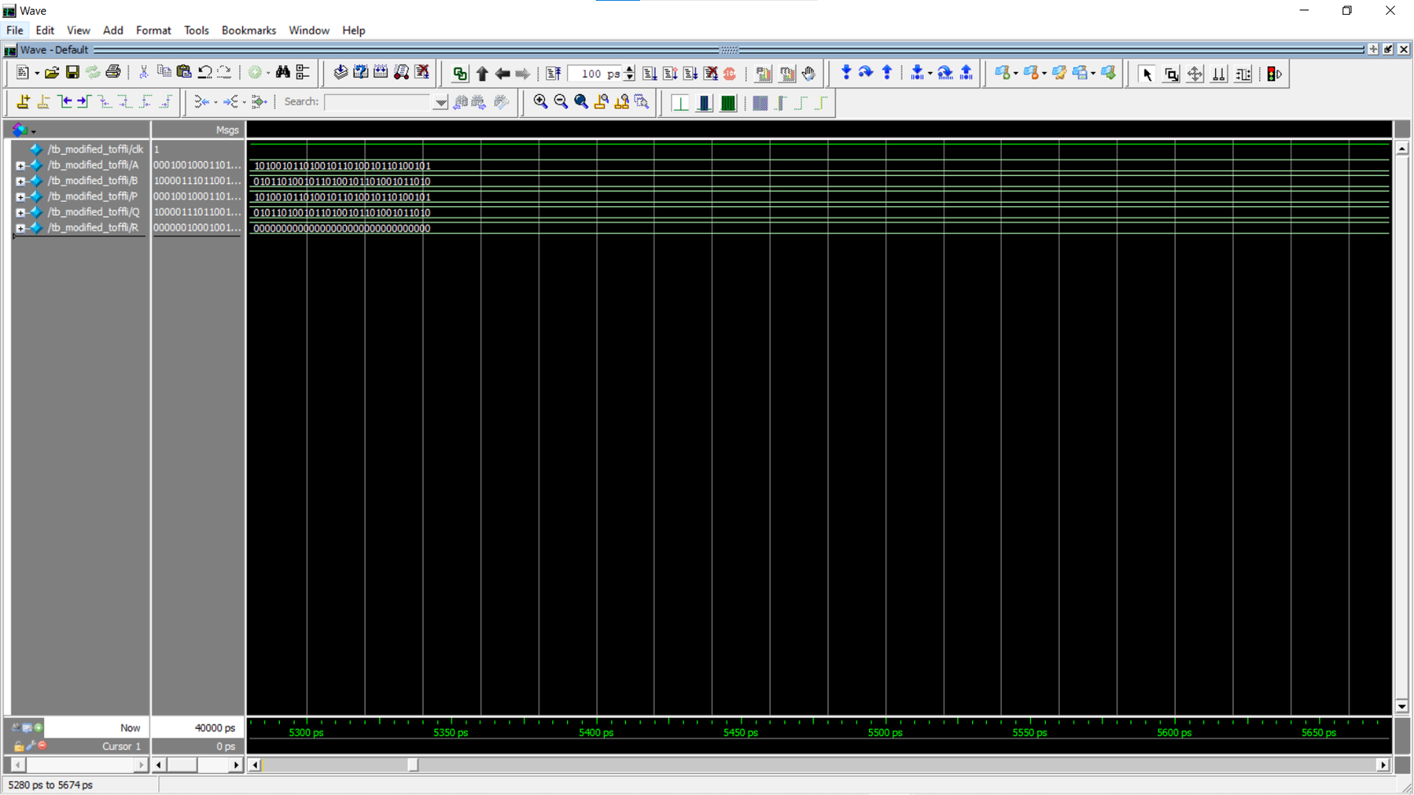

Slide 19
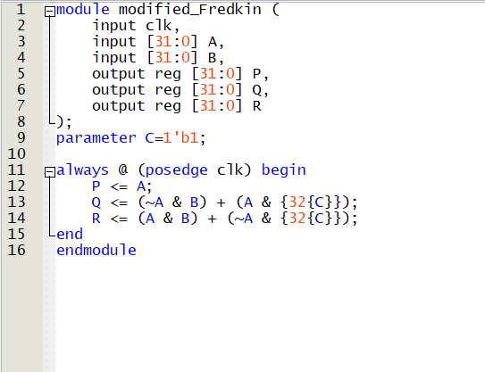
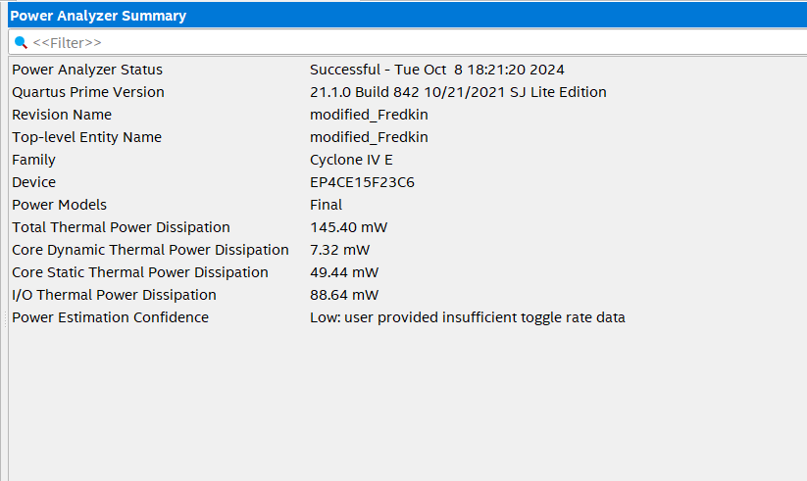
modified fredkin gate:

Slide 20
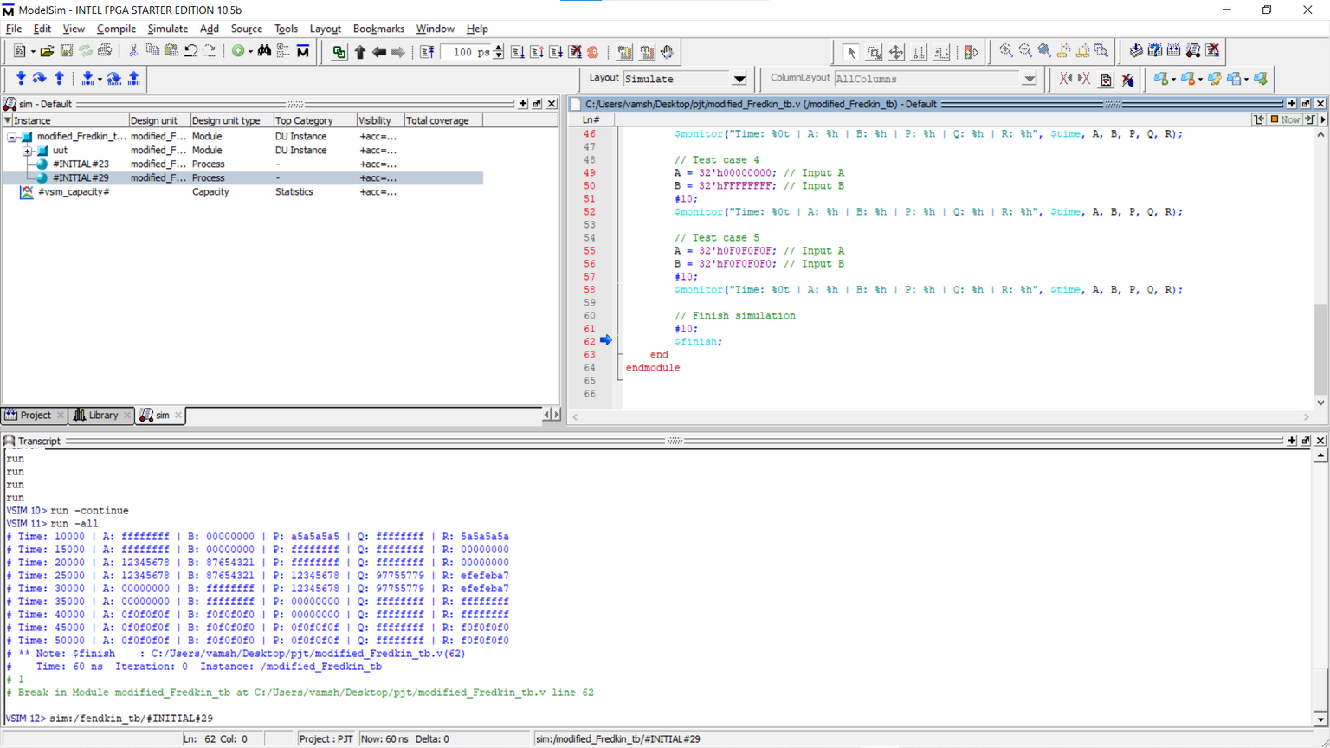

Slide 21
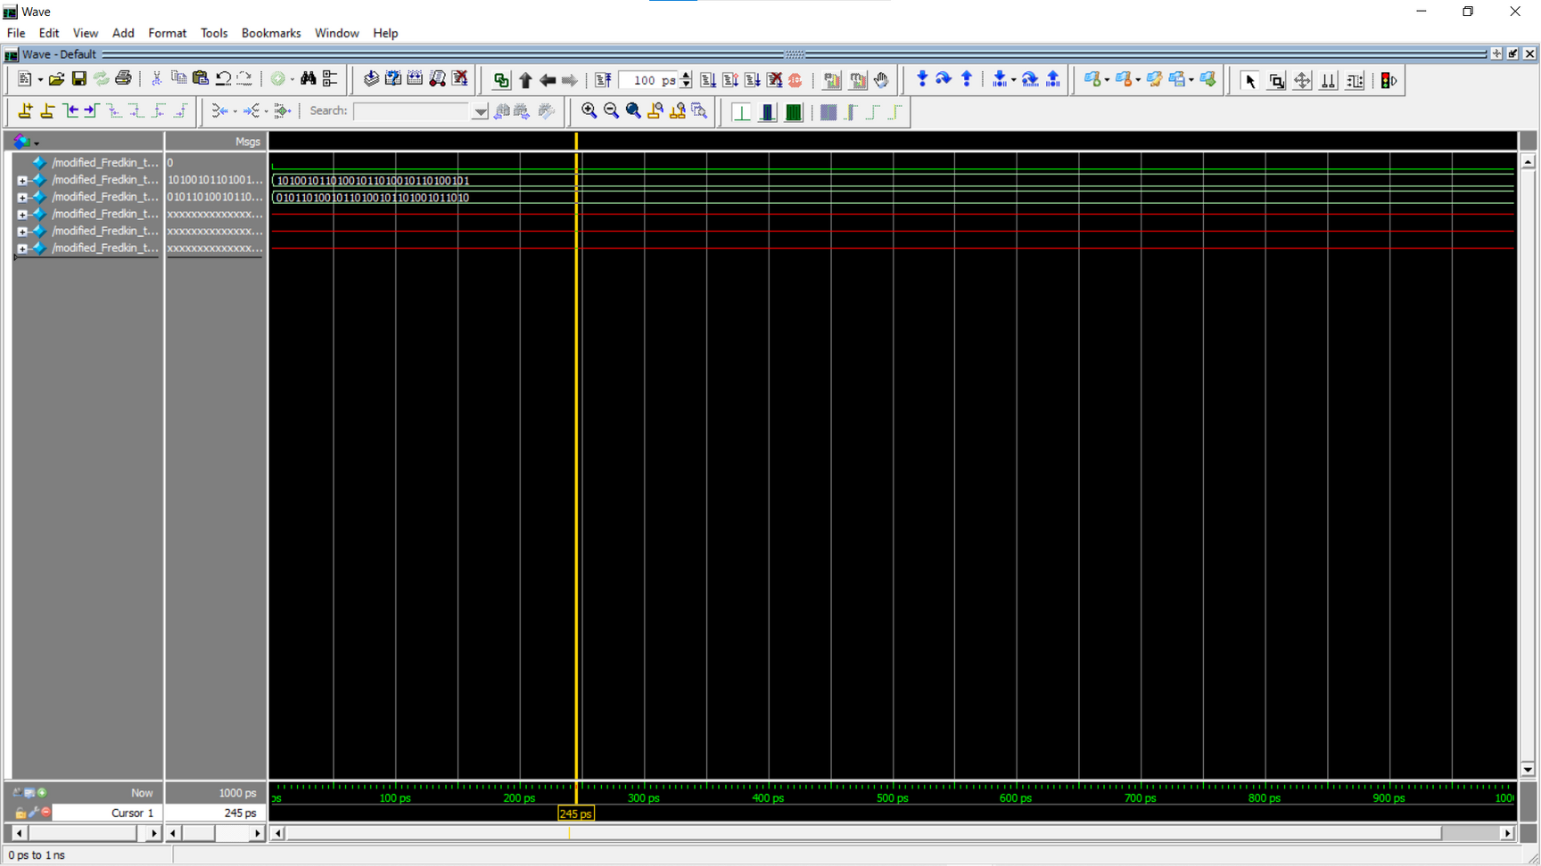

Slide 22
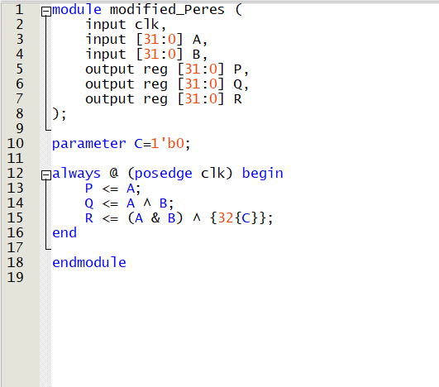
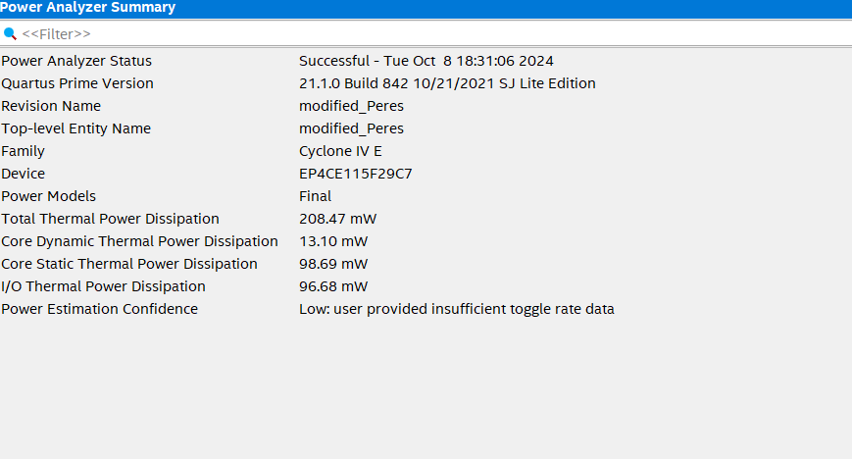
modified peres gate:

Slide 23
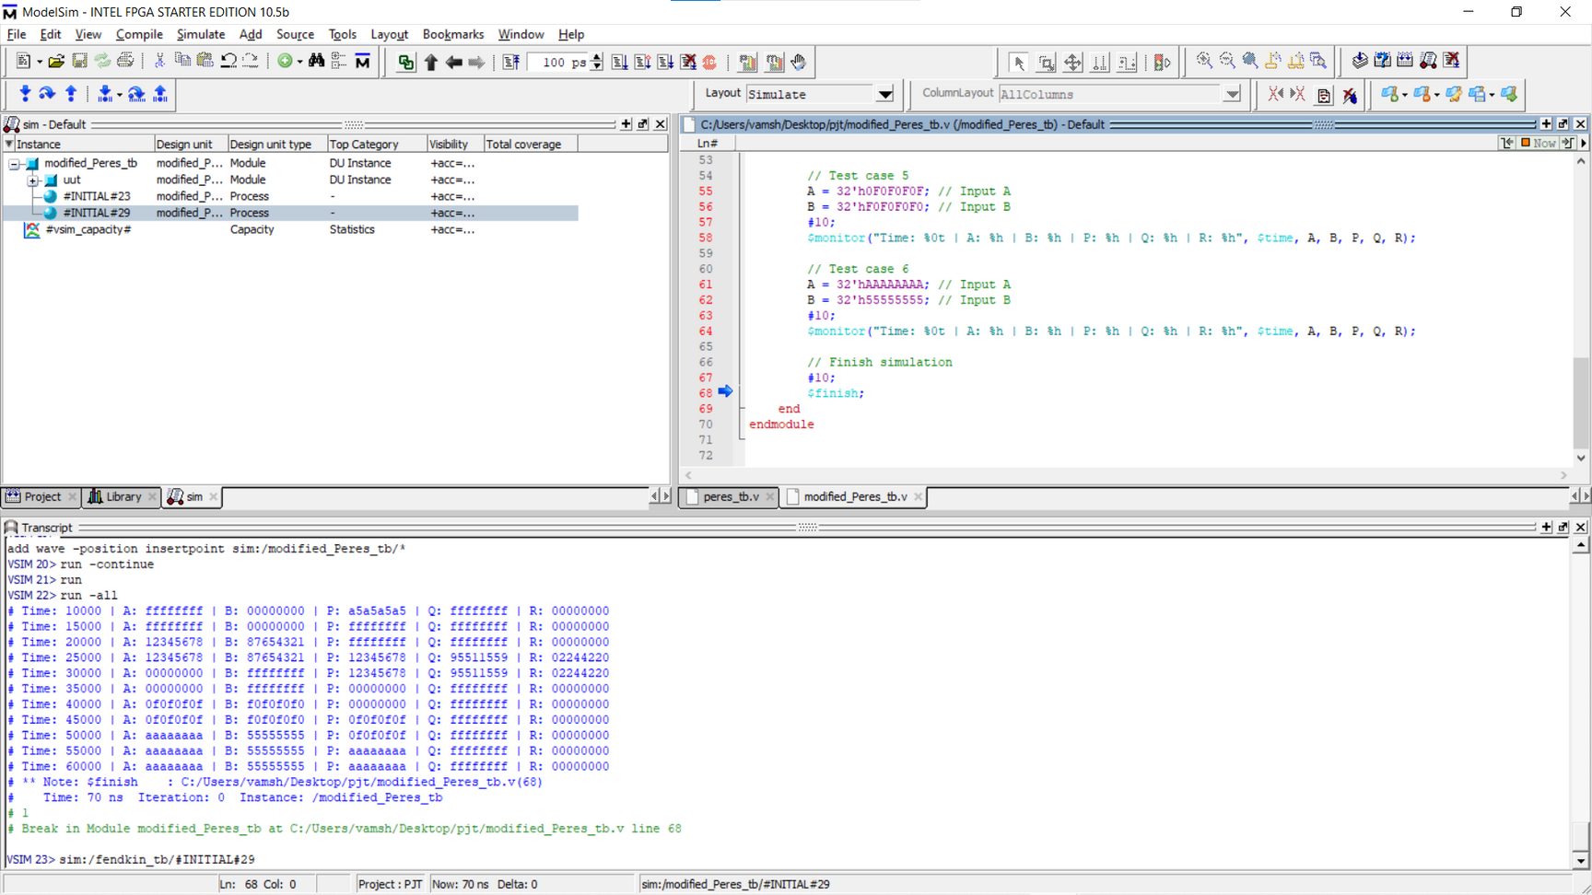

Slide 24
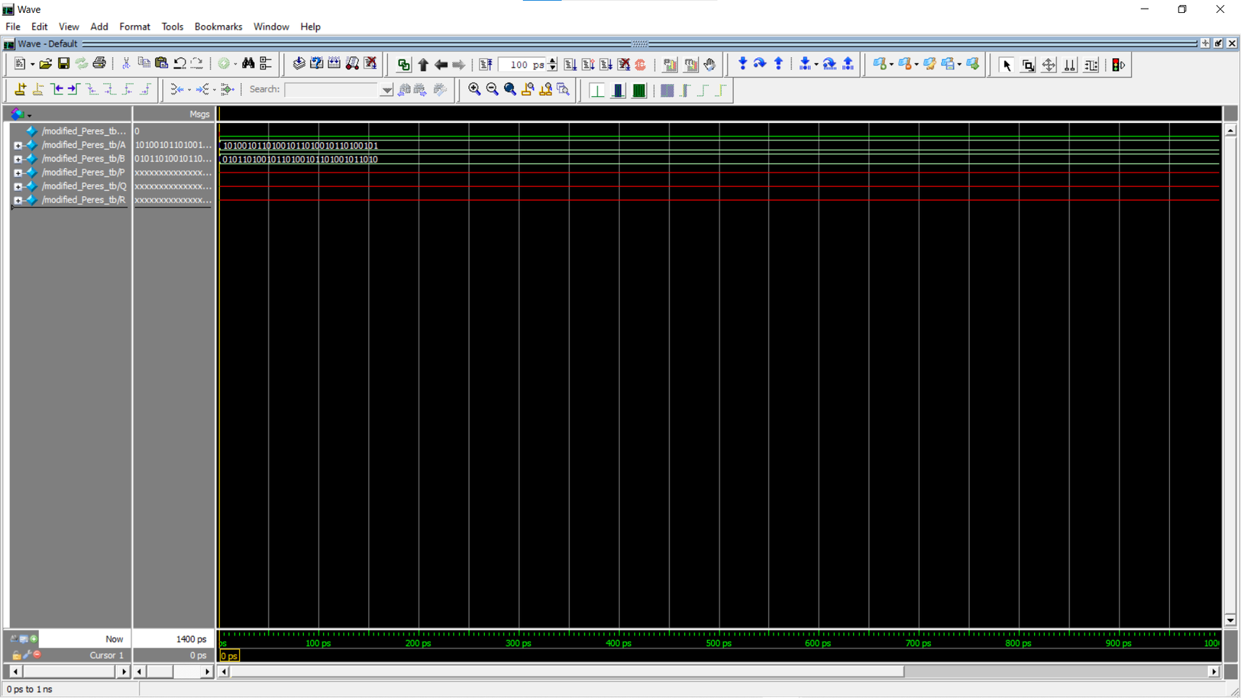

Slide 25
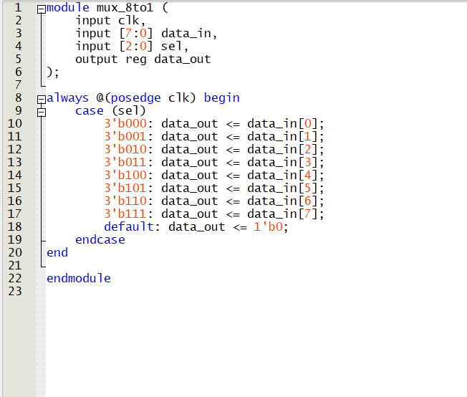
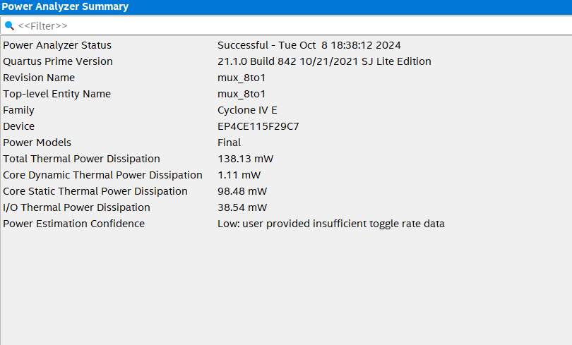
8:1 mux:

Slide 26
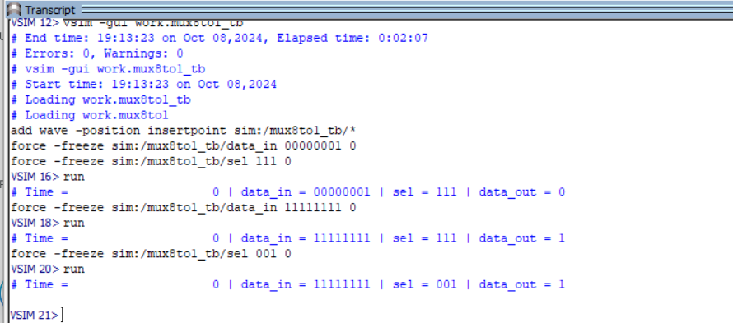

Slide 27
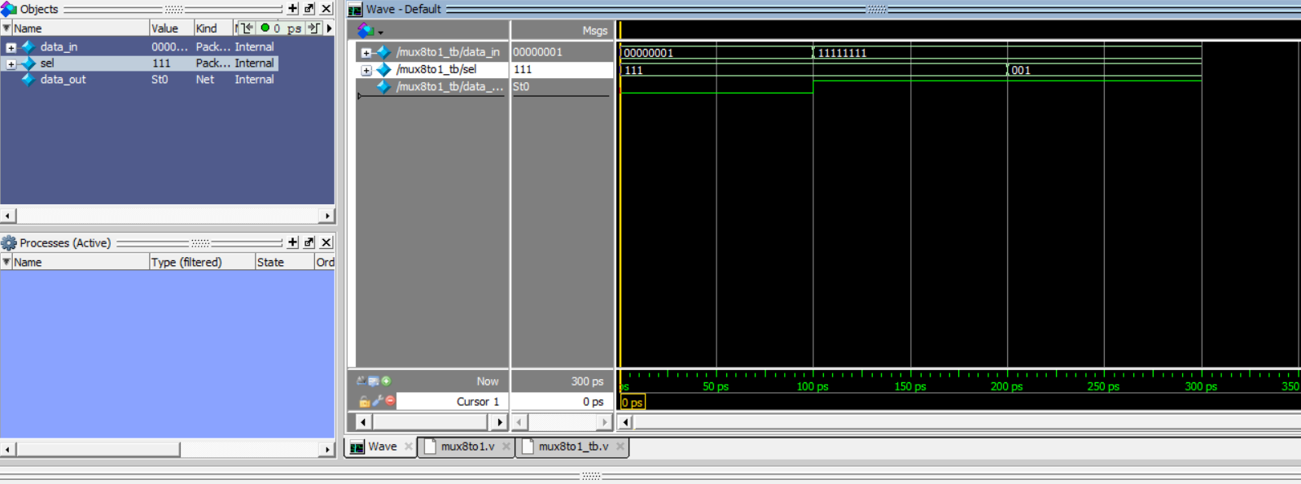

Slide 28
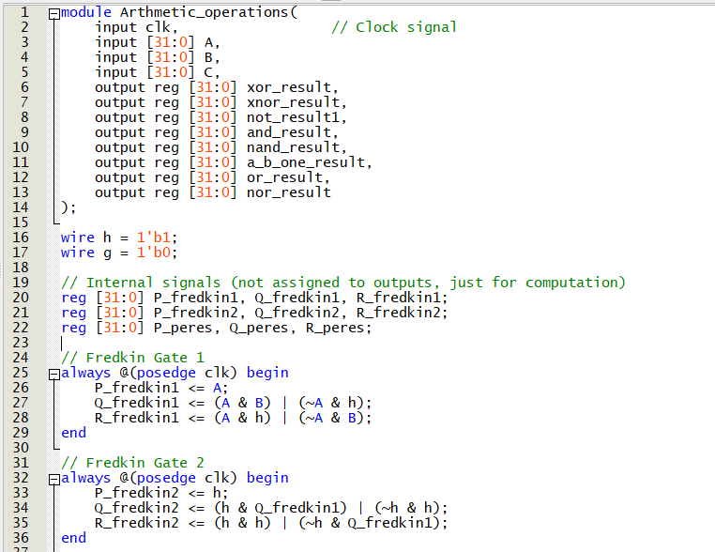
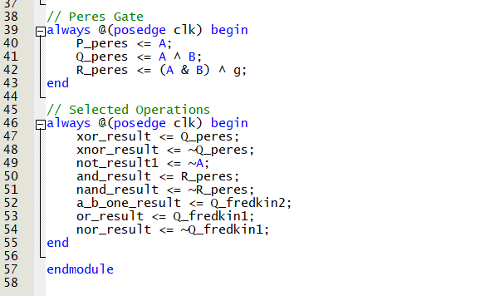
Arthimetic operations

Slide 29
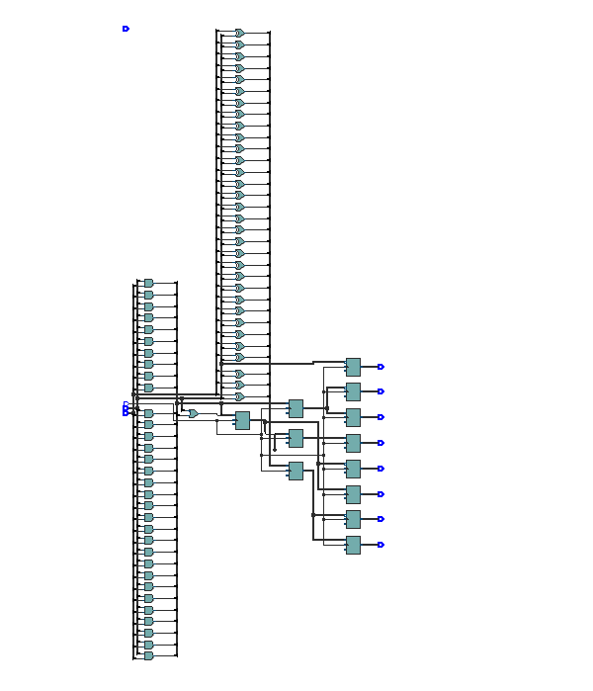
Arthimetic operations

Slide 30
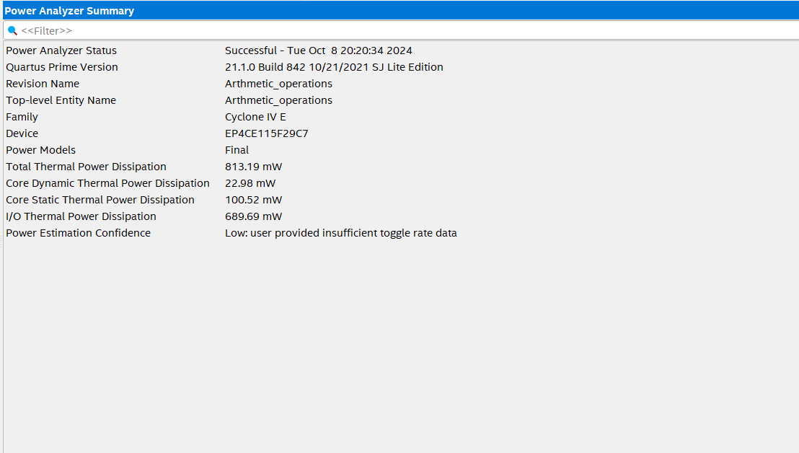

Slide 31
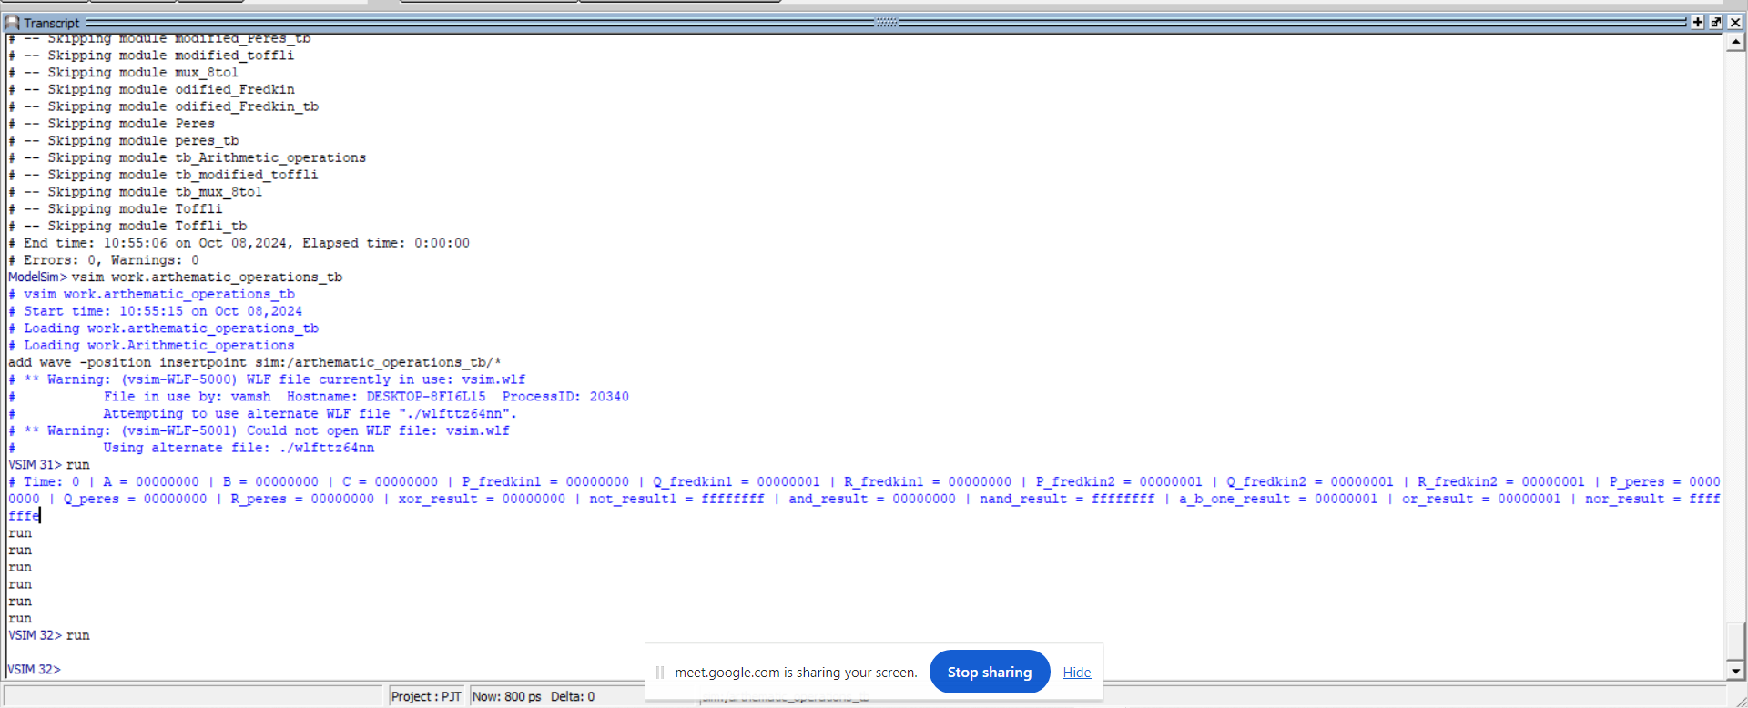

Slide 32
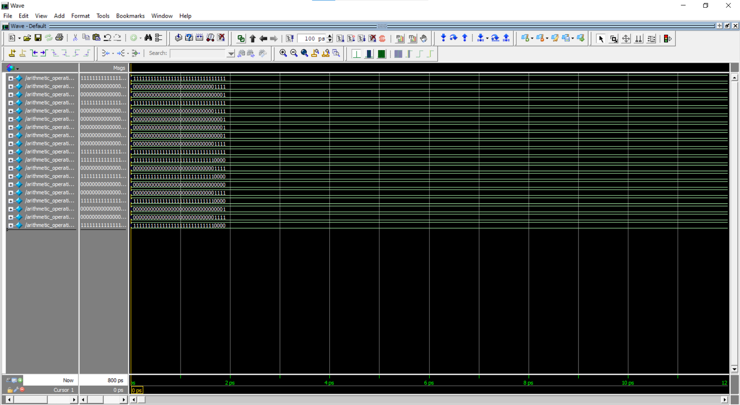

Slide 33
Results obtained so far:
reversible logic gates | Dynamic power
Feynman gate | 3.31mw
peres gate | 14.85mw
Toffoli gate | 12.92mw
Fredkin gate | 18.67mw
modified toffoli gate | 11.40mw
modified Fredkin gate | 7.32mw
modified Peres gate | 13.10mw

Slide 34
Example Real-Life Scenario for Reversible logic gates
Consider a data processing unit in a satellite. Energy efficiency is crucial because satellites rely on limited solar power. Implementing an ALU that uses reversible logic gates, such as Fredkin and Peres gates, could significantly reduce the power used during computation, allowing the satellite to operate efficiently over longer periods without exhausting its power supply.

Slide 35
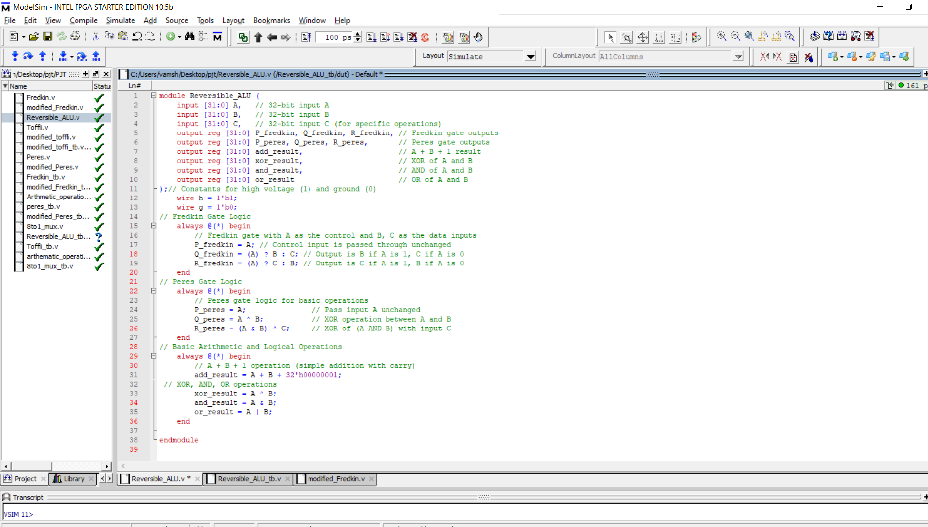
Code

Slide 36
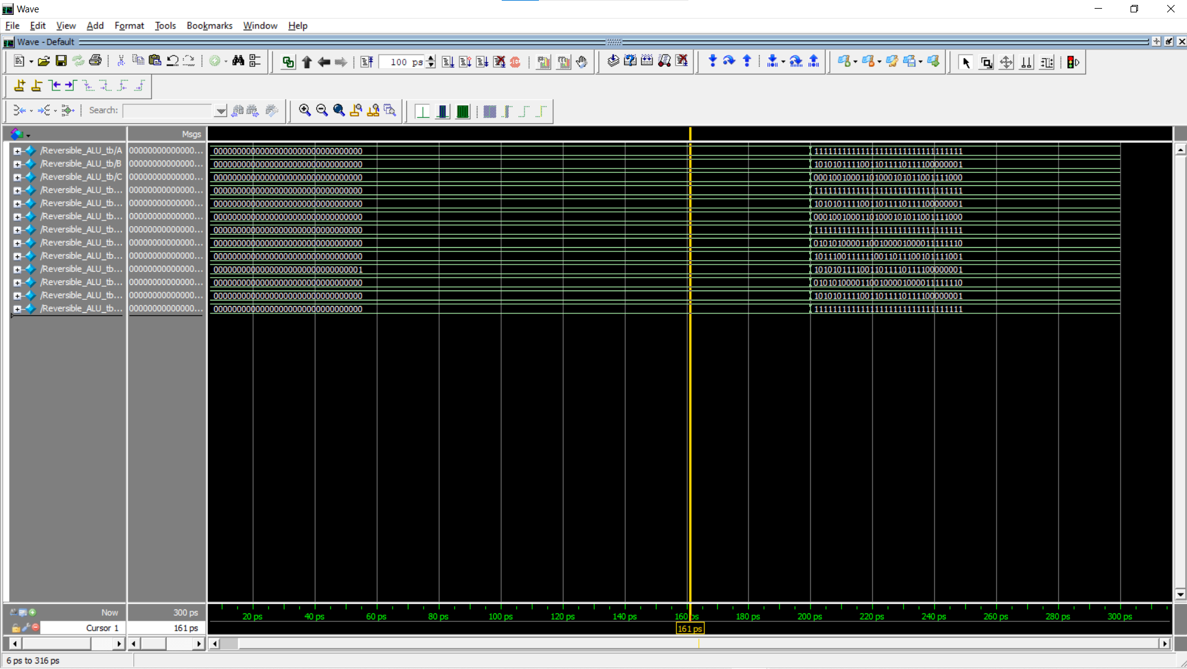
Output

Slide 37
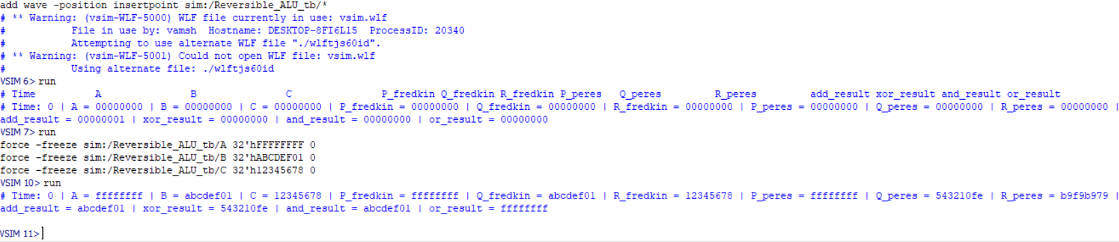
Transcript

Slide 38
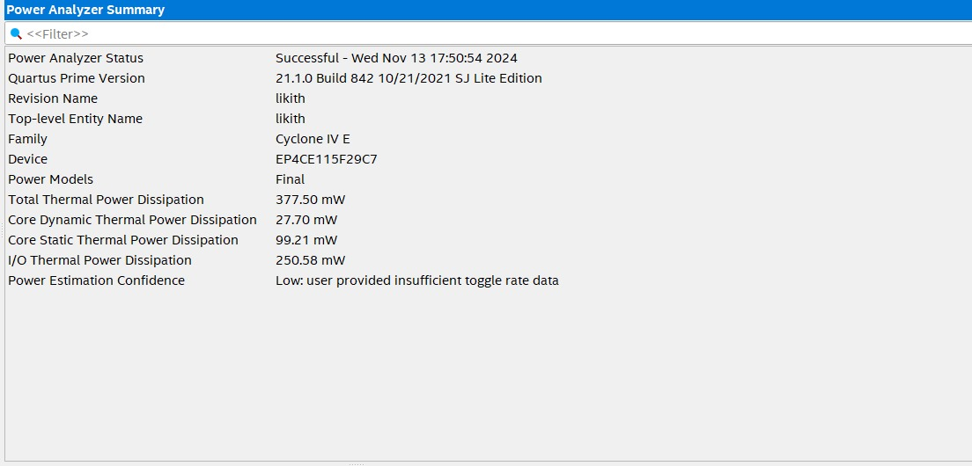
Flow Summary

Slide 39
How This Fits into a Satellite's Data Processing Unit
Energy Efficiency: The use of reversible gates ensures minimal energy loss, a key factor in space environments where power is limited.
Data Integrity: Reversible operations retain information, making them useful for error detection and correction in mission-critical computations.
Low Power Consumption: This design would allow a satellite to perform basic ALU functions with a reduced energy footprint, increasing the lifespan of its power source.

Slide 40
Example Real-Life Scenario for Non Reversible logic gates
Alarm systems, widely used in security, fire detection, and industrial safety, incorporate combinational logic to process sensor signals and make decisions. The design of these systems often involves non-reversible logic gates such as AND, OR, NAND, and NOT gates. Let’s delve into how these gates are utilized in a technical context, focusing on the underlying logic and circuit design principles

Slide 41
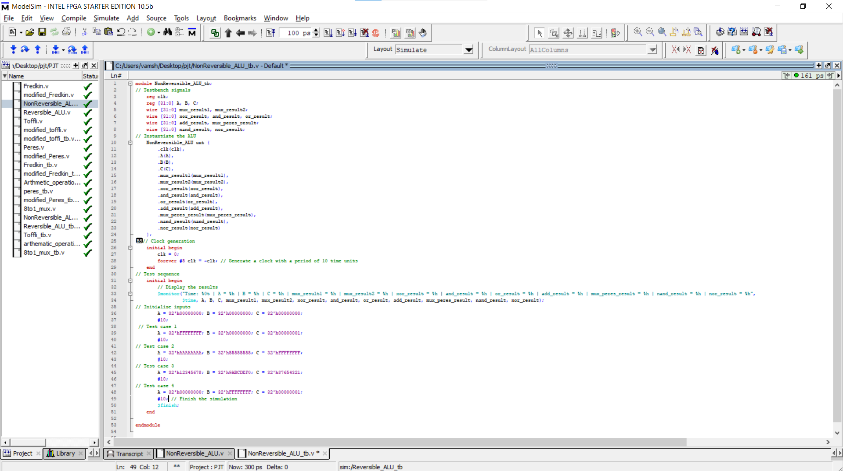
Code

Slide 42
Output

Slide 43
Transcript

Slide 44
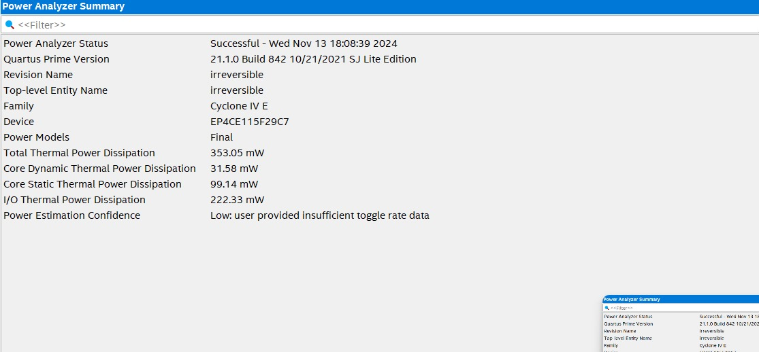
Flow Summary

Slide 45
How This Fits into a Satellite's Data Processing Unit
Data Processing: The ALU handles arithmetic and logic operations on sensor data, enabling calculations like distance and speed.
Encryption & Security: It performs XOR and other operations for secure communication and error detection in data transmission.
Control & Navigation: The ALU processes data from navigation sensors to compute satellite orientation and control its movement.

Slide 46
References
S. Sarkar, H. Chatterjee, P. Saha and M. Biswas, "8-Bit ALU Design using m-GDI Technique," 2020 4th International Conference on Trends in Electronics and Informatics (ICOEI) (48184), Tirunelveli, India, 2020, pp. 17-22, Doi: 10.1109/ICOEI48184.2020.9142881.
U. Ahmad, S. Ali, R. Ahmed, M. Y. Qadri and H. Saif, "Fault-Tolerant Reconfigurable 32-bit ALU for Space Applications," 2021 1st International Conference on Microwave, Antennas & Circuits (ICMAC), Islamabad, Pakistan, 2021, pp. 1-4, Doi: 10.1109/ICMAC54080.2021.9678251.
S. N, P. S. S, B. A and C. D. Rebeak, "Design and Simulation of Low Power 2:1 Multiplexer based Ternary ALU for Processor," 2022 International Conference on Sustainable Computing and Data Communication Systems (ICSCDS), Erode, India, 2022, pp. 766-773, Doi: 10.1109/ICSCDS53736.2022.9760829. 9

Slide 47
References
M. Morrison and N. Ranganathan, "Design of a Reversible ALU Based on Novel Programmable Reversible Logic Gate Structures," 2011 IEEE Computer Society Annual Symposium on VLSI, Chennai, India, 2011, pp. 126-131, doi: 10.1109/ISVLSI.2011.30
B. Jana, A. Jana, S. Basak, J. K. Sing and S. K. Sarkar, "Design and performance analysis of reversible logic based ALU using hybrid single electron transistor," 2014 Recent Advances in Engineering and Computational Sciences (RAECS), Chandigarh, India, 2014, pp. 1-4, doi: 10.1109/RAECS.2014.6799652

Slide 48


Thank you!
Insert a parting or call-to-action message here.

